Slide 1
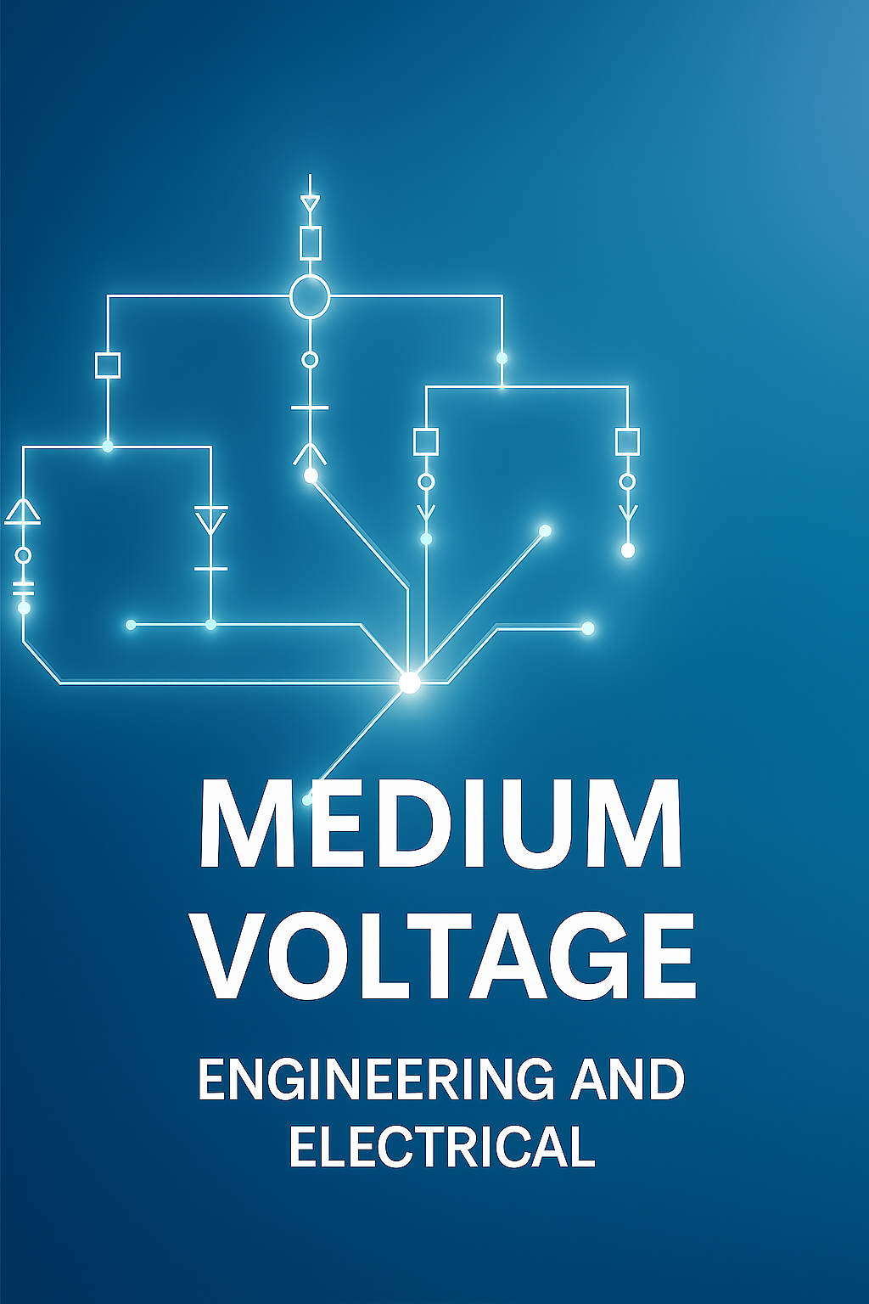

Slide 2


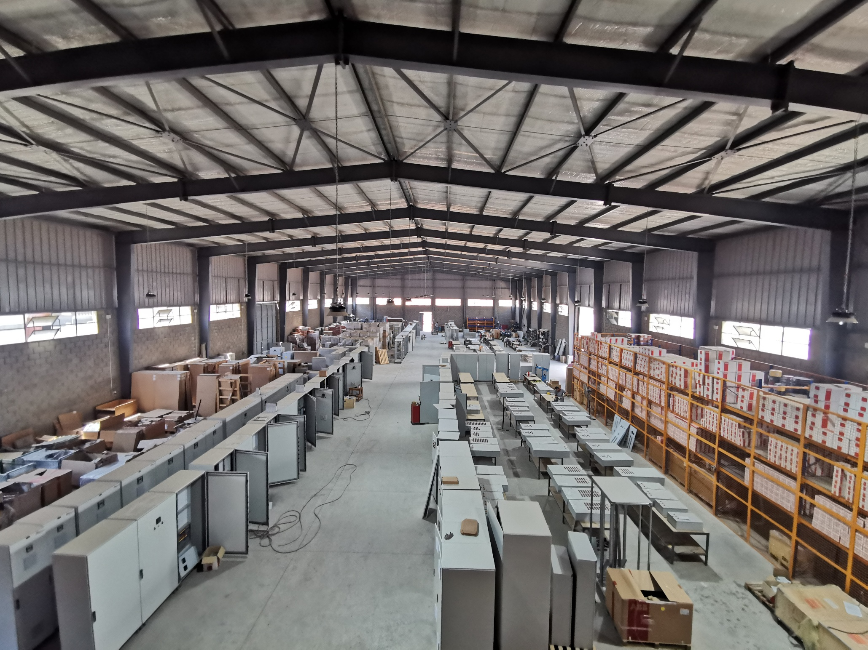

inco-Tech, an ABB authorized panel builder, creates low voltage switchboards. Founded by experienced engineers with 30+ years in ABB and Electrical Distribution Field, we deliver top-notch performance, advanced protection, and seamless integration with energy management systems. Our components and support ensure efficient delivery for you and your customers.

Slide 3

Product Overview
The Inco-Tech Air-Insulated RMU is a modular and compact metal-enclosed switchgear for secondary distribution networks up to 24 kV. It features a three-position switch (ON-OFF-EARTH), maintenance-free operation, and a robust enclosure suited for indoor applications. is the result of continuous innovation, following the desire to meet ever-changing market needs.
Technical Characteristics
RMU Type | INCO-SEC
Rated Voltage (kV) | 12
Rated Current (A) | 630
Rated Frequency (Hz) | 50
Ambient Temperature (°C) | 45
Rated Short Circuit (kA/1s) | 25
Power Frequency Withstand Voltage (kV) | 28
Lightning Impulse Withstand Voltage (kV) | 75

Slide 4
Standards Compliance
Complies with IEC 62271-1, IEC 62271-200, IEC 62271-102, IEC 62271-103, IEC 62271-105, and IEC 61850 standards for switchgear and controlgear systems.
Installation & Maintenance
Delivered fully assembled, tested, and ready for installation. Easy handling with lifting hooks and base frames. Requires minimal maintenance - only fuse replacement as necessary

Slide 5
Main Features
- Air-insulated design for maximum safety - Compact modular panels - Mechanically interlocked operating system - SF6 or air-insulated versions - Advanced protection relays and automation options - Designed to IEC 62271-200 LSC2A-PM classification
arameter | 12 kV | 24 kV
Rated Voltage (kV) | 12 | 24
Service Voltage (kV) | 11 | 22
Rated Frequency (Hz) | 50 | 50
Power Frequency Withstand Voltage (kV) | 28 | 50
Lightning Impulse Withstand Voltage (kV) | 75 | 125
Rated Current - Main Busbars (A) | 630 | 630
Rated Short-Time Withstand Current (3s) (kA) | 25 | 20
Peak Current (kA) | 62.5 | 50

